Slide 1
Diabetes
Kellie Liu, Tony Tao, Elan Guo

Slide 2
Contents
Intro to Diabetes
Analyzing
Conclusion / Sum up

Slide 4

US Diabetes by County, 2004

Slide 5

US Diabetes by County, 2008

Slide 6
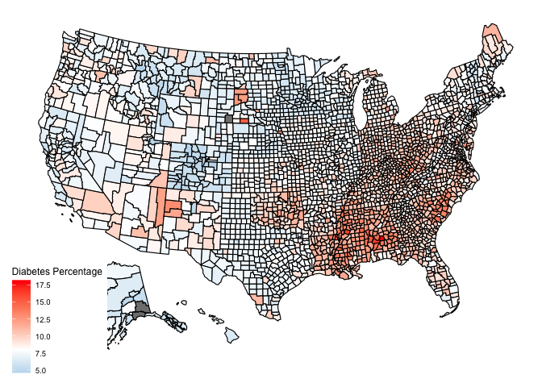
US Diabetes by County, 2012

Slide 7

US Diabetes by County, 2016

Slide 8

US Diabetes by County, 2020

Slide 9
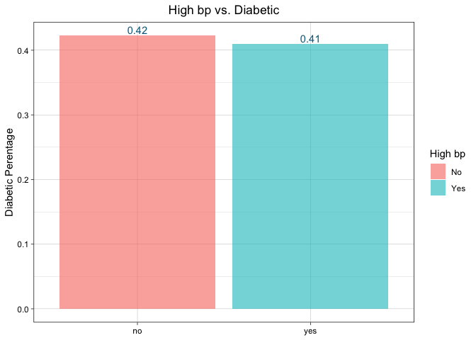
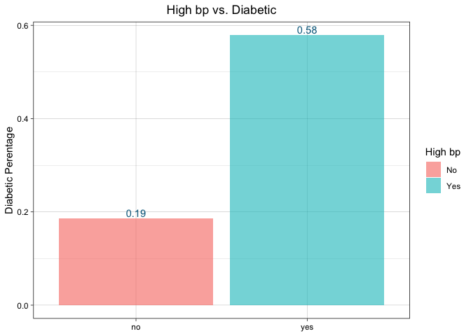
High Blood Pressure vs. Diabetes

Slide 10
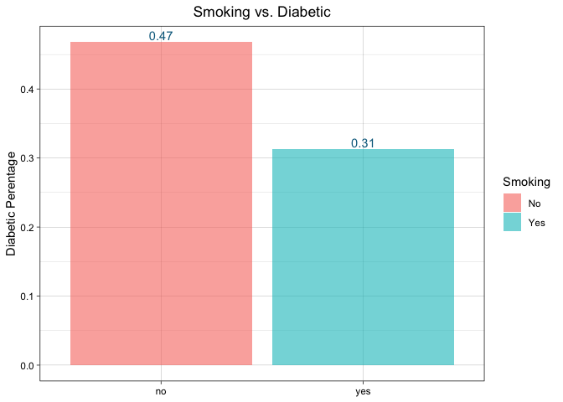
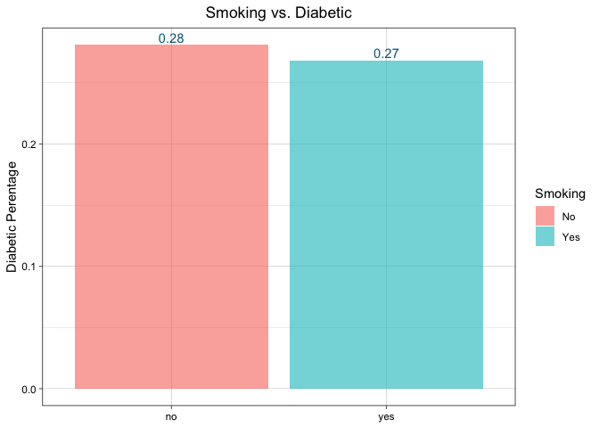
Smoking vs. Diabetes

Slide 11
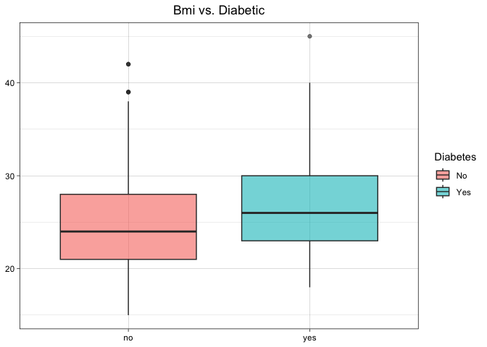
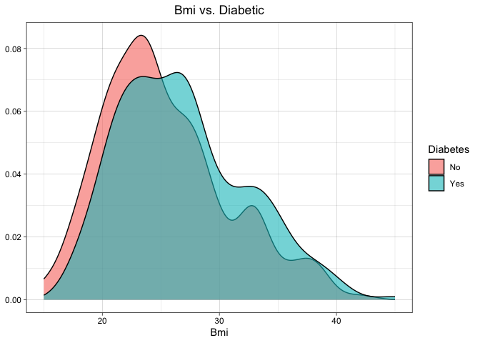
BMI VS. DIABETES

Slide 12
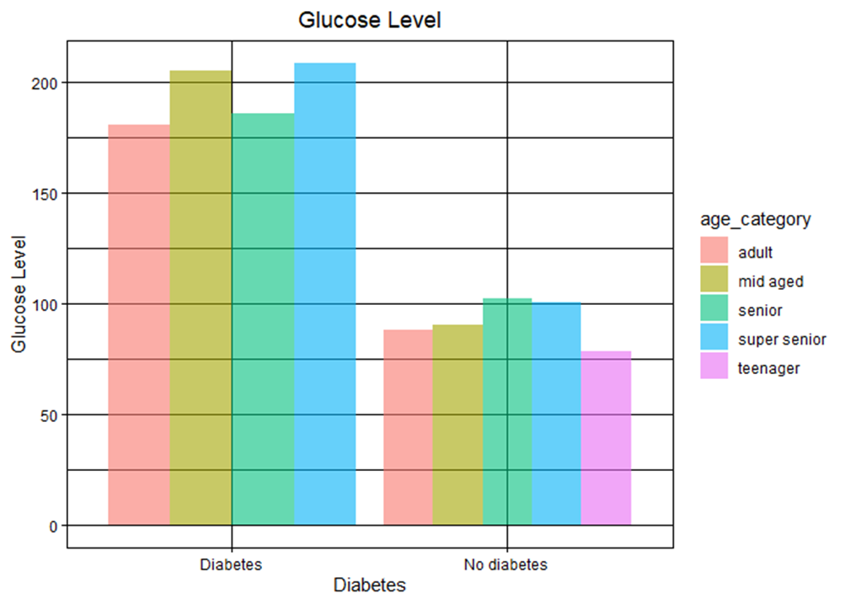
Glucose Level vs. Diabetes
Typically, fasting plasma glucose is below 100 mg/dl
Impaired: 100~125 mg/dl
Diabetic: >126 mg/dl
Notes:
Under normal circumstances, when the glucose levels in your bloodstream rise, such as after a meal, your pancreas secretes insulin which prompts your body to absorb the excess glucose until the levels return to normal. But if you have diabetes, like type 1 diabetes, the pancreas either doesn't produce insulin, or like type 2 diabetes, the body fails to respond to insulin effectively. Then that can leave your blood sugar too high for too long. Over time, this can cause damage to blood vessels and nerves, and may lead to the development of heart disease and other complications over time.

Slide 13
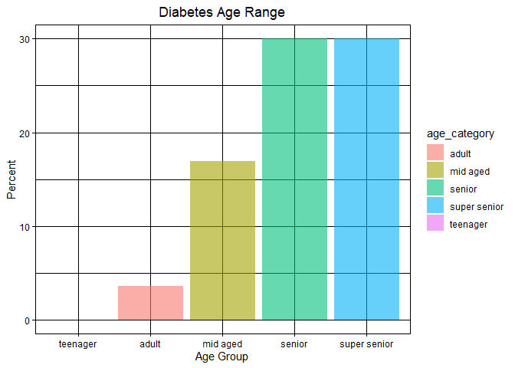
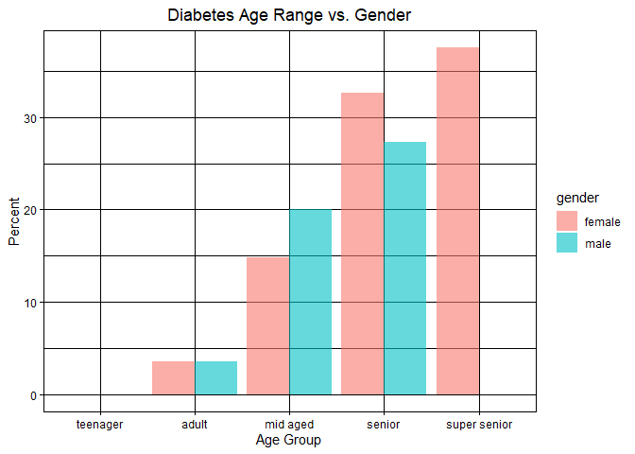
Age Range vs. Diabetes
Notes:
4 categories: age<=19~"teenager", for age between 20 & 40~"adult", for age between >=40 &<60~"mid aged", for age between >=60 & <80~"senior", age>=80~"super senior"
Older adults are at high risk for the development of diabetes due to the combination of increasing insulin resistance and impaired pancreatic function with aging, these impairments can highly ruin the process of glucose absorption.
At this age, multiple medical conditions occur, including high blood pressure and high cholesterol. That can make it harder for people to keep their diabetes under control.

Slide 14
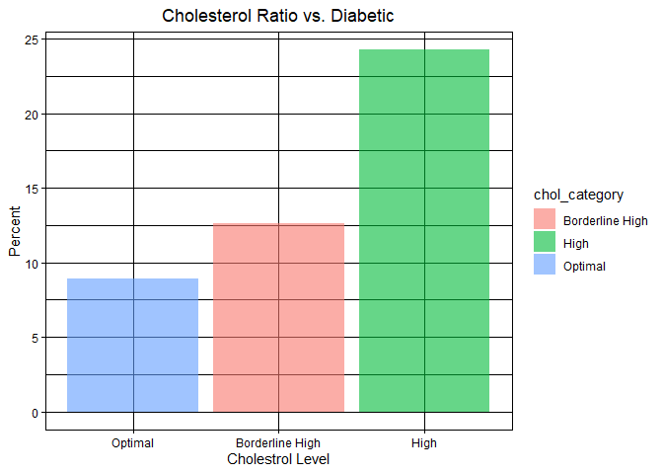
Cholesterol Level vs. diabetes
Indicators of Diabetes:
Decrease in the levels of HDL (good) cholesterol
Increase in the levels of triglycerides and LDL (bad) cholesterol
Notes:
Diabetes frequently leads to reducing the levels of HDL (beneficial, high-density lipoprotein) cholesterol while increasing the levels of triglycerides and LDL (harmful, low-density lipoprotein) cholesterol.
Eventually increase the risk for heart disease and stroke.
chol_ratio<=3.5~"Optimal", chol_ratio>=3.5 & chol_ratio<5~"Borderline High", chol_ratio>=5~"High"

Slide 15
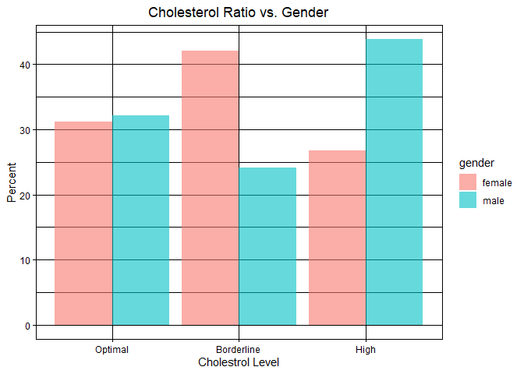
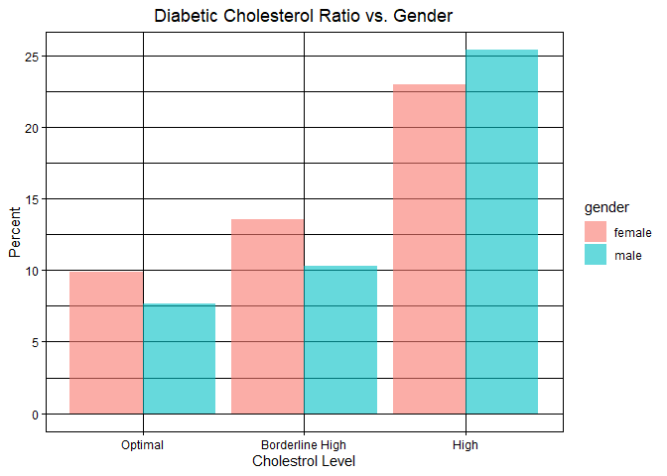
Cholesterol Level vs. diabetes

Slide 16
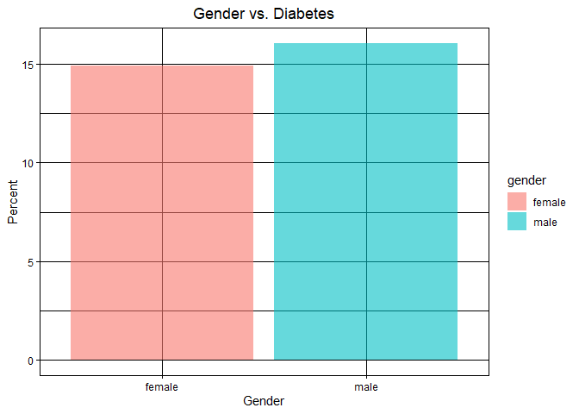
Gender Vs. Diabetes
Overall, no sex bias

Slide 17
Thank you

